Slide 1
INSTINCTIVE CANOPY MECHANISM
SYNOPSIS
INTRODUCTION
TOOLS USED
PROBLEMS STATEMENT
SURVEY
METHODOLOGY
CONCLUSION
TEAM NAME
INNOVATIVE INSTALLERS
1

Slide 2
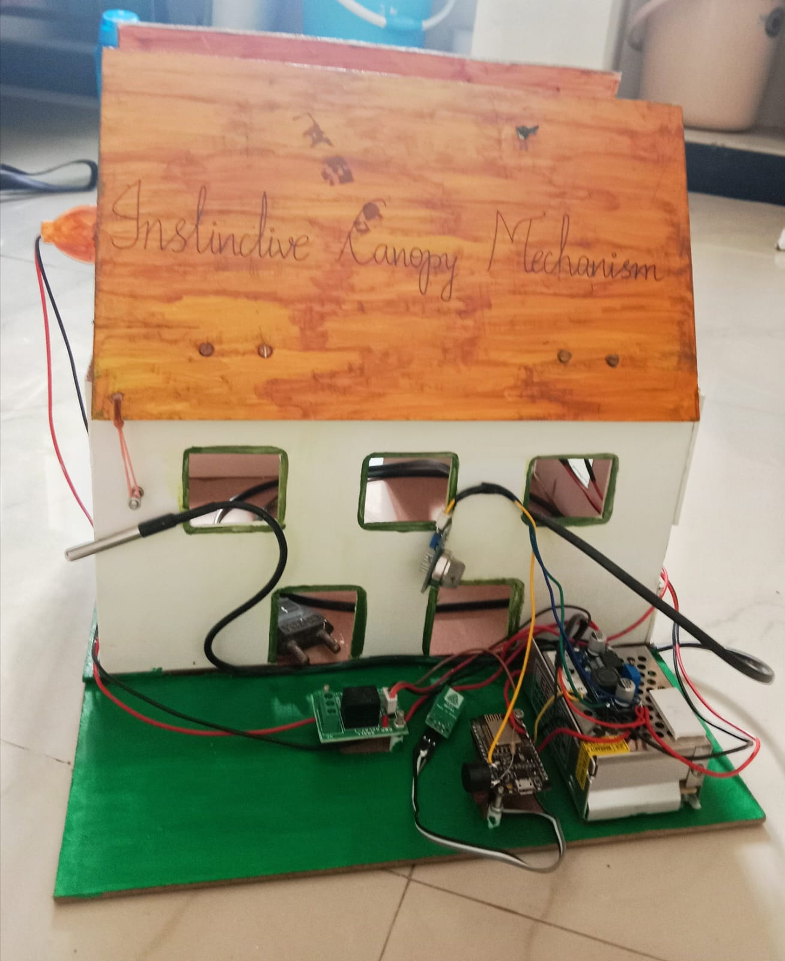
Instinctive Canopy Mechanism

Slide 3
INTRODUCTION
In 1999, the phase " Internet of Things (IoT) " was first used .
IoT refers to a certain type of network that uses the internet to connect numerous devices.
The " Network of Networks " is how the term " Internet " is used.
In this presentation we would like to share our idea in which we have used the concept of " Internet Of Things " , that are useful for farmers to solve their economic problems
Instinctive Canopy Mechanism
2

Slide 4
TOOLS USED
HUMIDITY SENSOR
Humidity sensors are used for several application for measuring humidity.
TEMPERATURE SENSOR
Temperature sensors are devices used to measure temperature in solids, liquids or gases.
AIR QUALITY SENSOR
Air quality sensors are devices used to detect pollutants and toxic gases that are harmful to human health
SERVO MOTOR
The voltage supply provided by the junction box will be decreased by the servo motor.
NODE MCU CONTROLLER
Node MCU controller is used to lower the voltage supply from the Servo motor.
Instinctive Canopy Mechanism
3

Slide 5

PROBLEM STATEMENT
In India , due to heavy rain most of the plants are destroyed and spoiled at the same time plants loose their nutrients due to insect bites . Low humidity affects plant's stomata. If a part of stored yield gets spoiled it will affect the other parts of the stored yield
Instinctive Canopy Mechanism
4

Slide 6
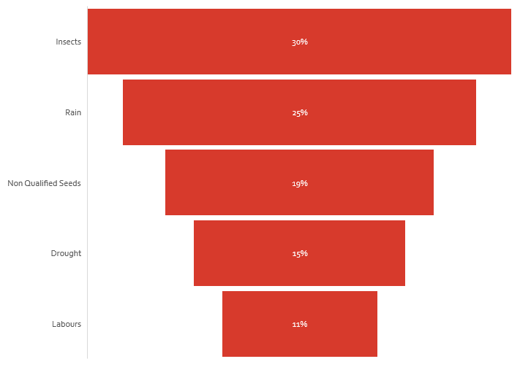
survey
Crop Destruction Reasons
As per the survey , major destructions of crops are insects and rain.
So this project mainly focuses on these destruction to be precautions.
Instinctive Canopy Mechanism
5

Slide 7
METHODOLOGY
Starting with the humidity sensor, the control unit (i.e., servo motor) urges the Node MCU controller to close the roof when the humidity level in the air rises. It keeps the harvested yields from getting wet ,as a result the stored yields will be insect free.
The temperature regulator sensor controls the temperature to avoid the cultivation of insects, keep the harvested grains (or) yields insects free, and maintain the required temperature that the yields needed during winter season.
The air quality sensor, detects the smell of any spoiled food inside the cottage and rings the buzzer, preventing further spoilage.
Humidity sensor
Temperature regulator
AIR QUALITY SENSOR
Instinctive Canopy Mechanism
7

Slide 8
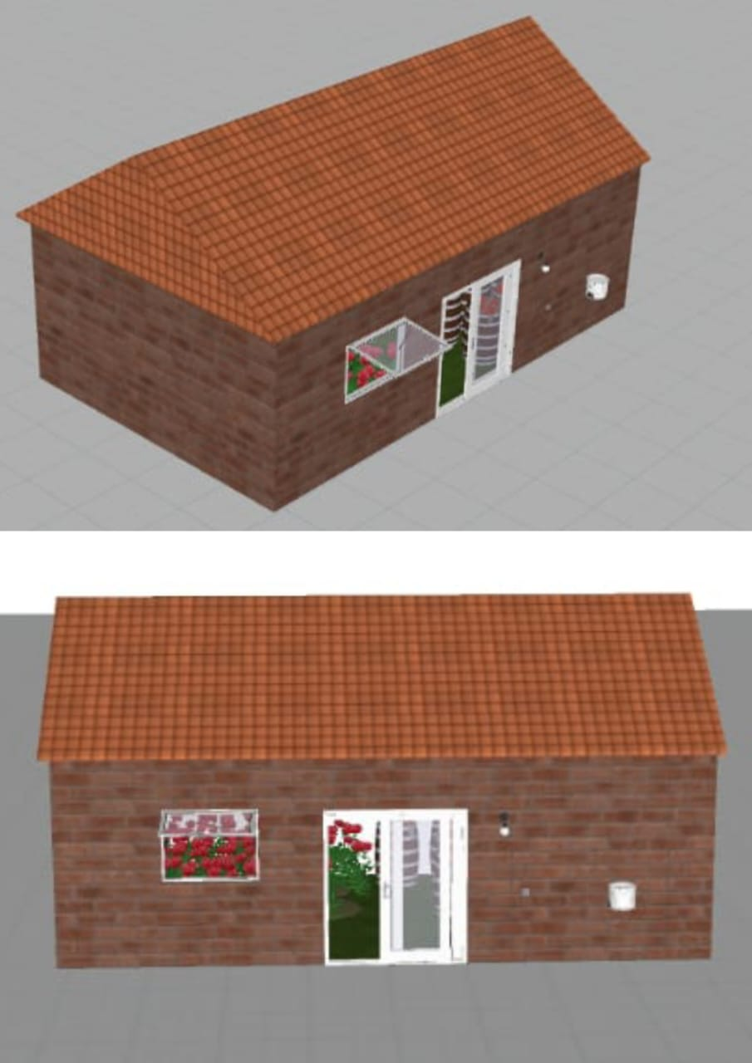
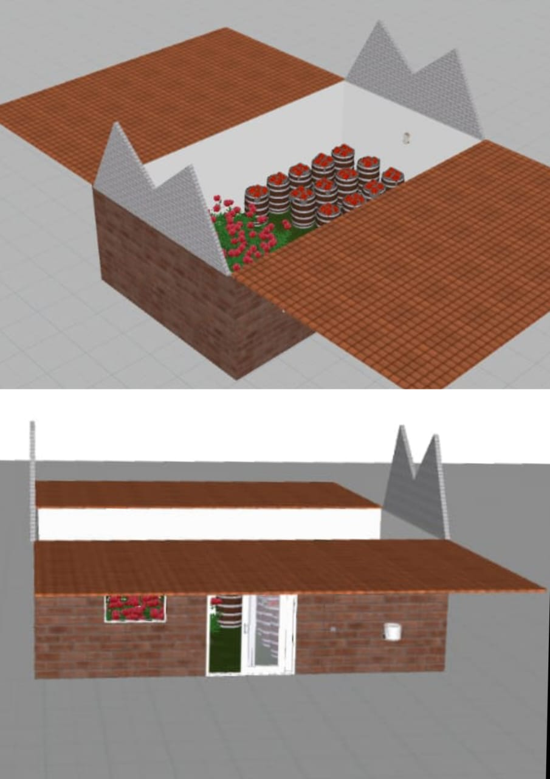
conclusion
So far in the agricultural sector, no products have been launched regarding the above mentioned
problems. Our team has taken the initiative to solve these problems and launch as product.
Instinctive Canopy Mechanism
7

Slide 9
THANK YOU
Instinctive Canopy Mechanism
8

